Slide 1
Accelerator and Winograd Convolution
Paper Review

Slide 2
Contents
Algorithm
Accelerator based on Winograd convolution
Sparse Winograd Convolutional neural networks on small-scale systolic arrays
SpWA
Winograd-ReLU CNN

Slide 3
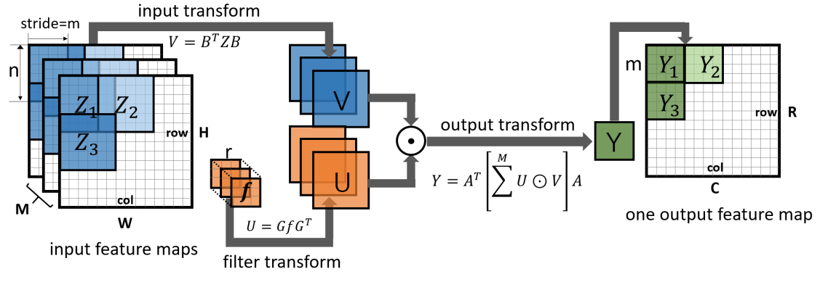
Algorithm

Slide 4



Algorithm
Features
The transform matrixes $B$ and $G$ are only related to the value of $m$ and $r$
The stride of corresponding spatial-convolution should be 1
$$m=2 r=3$$
$$m=4 r=3$$

Slide 5
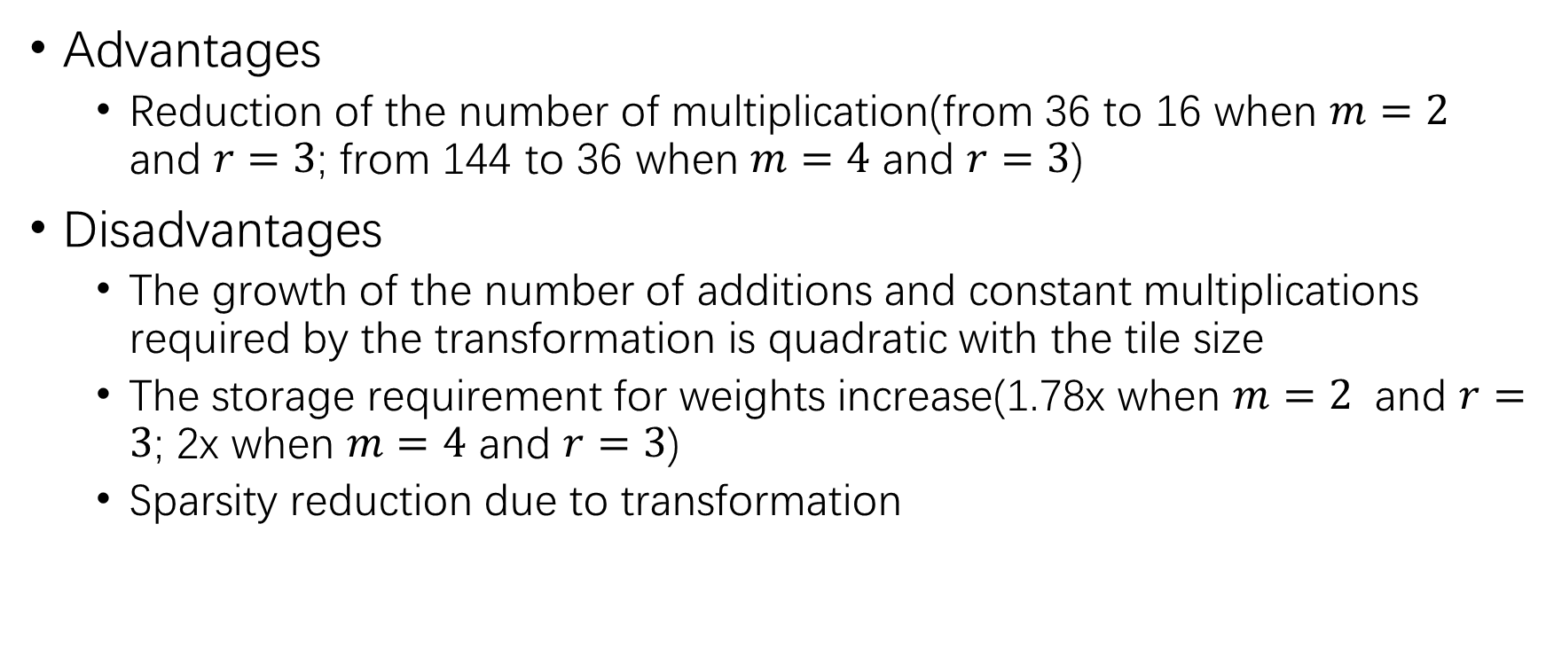
Algorithm
Advantages
Reduction of the number of multiplication(from 36 to 16 when $m=2$ and $r=3$; from 144 to 36 when $m=4$ and $r=3$)
Disadvantages
The growth of the number of additions and constant multiplications required by the transformation is quadratic with the tile size
The storage requirement for weights increase(1.78x when $m=2$ and $r=3$; 2x when $m=4$ and $r=3$)
Sparsity reduction due to transformation

Slide 6

Algorithm
Winograd algorithm with $m=2$and $r=3$ are widely used in recent works
Acceptable storage requirement increase
No multiplication in input feature map transformation
Kernel with 3 x 3 are popular in recent convolution neural networks

Slide 7
Accelerator based on Winograd convolution Sparse Winograd Convolutional neural networks on small-scale systolic arrays
Contributions
Unified small-scale systolic arrays for both Winograd transform and matix multiplication
Efficient memory access layout
Block-based sparse matrix compression

Slide 8
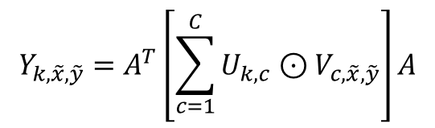



Accelerator based on Winograd convolution Sparse Winograd Convolutional neural networks on small-scale systolic arrays
Dataflow
Add channel dimension: →
Transform to matrix multiplication:
Three steps: input feature map transformations, matrix multiplications, inverse transformation of the output feature maps
$$Y_{k,\tilde{x},\tilde{y}}=A^{T}\left[\sum_{c=1}^{C}{U_{k,c}⊙V_{c,\tilde{x},\tilde{y}}}\right]A$$
$$Y=A^{T}\left[\left(GgG^{T}\right)⊙\left(B^{T}dB\right)\right]A$$
$$M_{k,\tilde{x},\tilde{y}}=\left[\sum_{c=1}^{C}{U_{k,c}⊙V_{c,\tilde{x},\tilde{y}}}\right]$$
$$M_{\left(k,b\right)}^{\left(i,j\right)}=\sum_{c=1}^{C}{U_{k,c}^{\left(\tilde{i},\tilde{j}\right)}}V_{c,b}^{\left(\tilde{i},\tilde{j}\right)}$$

Slide 9
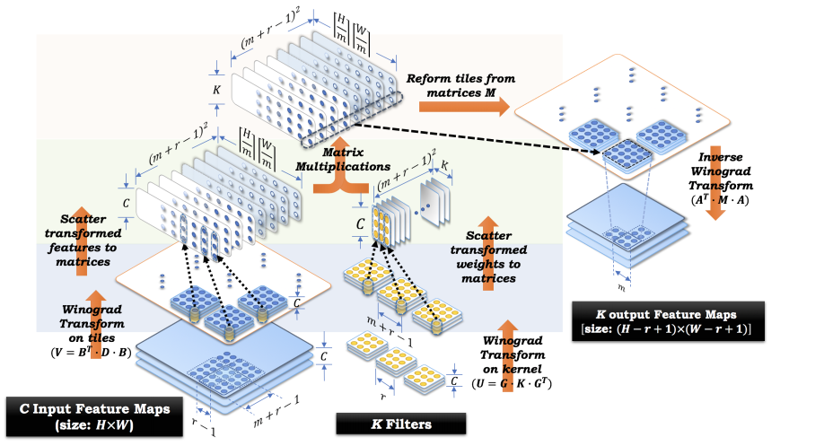
Accelerator based on Winograd convolution Sparse Winograd Convolutional neural networks on small-scale systolic arrays
Dataflow

Slide 10
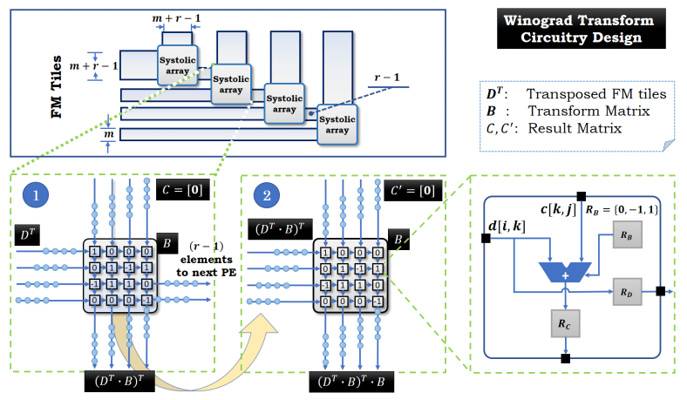


Accelerator based on Winograd convolution Sparse Winograd Convolutional neural networks on small-scale systolic arrays
Winograd transform by Systolic Arrays
Change to
Data sharing between overlapping tiles
$$B^{T}DB$$
$${\left(D^{T}B\right)}^{T}B$$

Slide 11
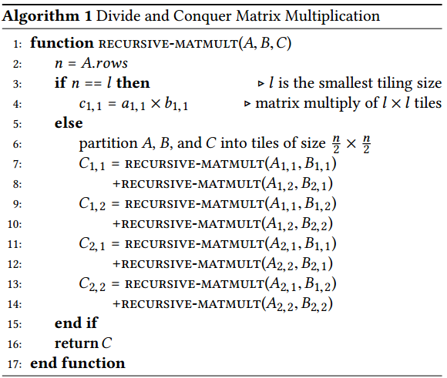
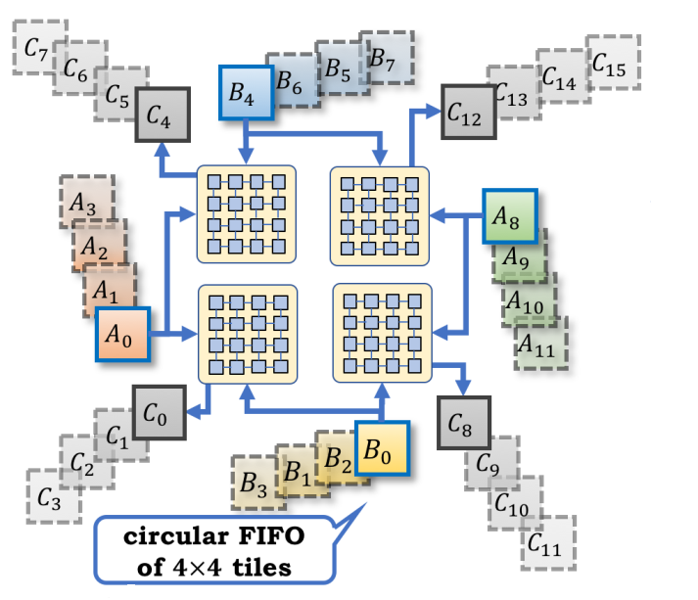
Accelerator based on Winograd convolution Sparse Winograd Convolutional neural networks on small-scale systolic arrays
Matrix Multiplication by Systolic Arrays
Algorithm
Architecture

Slide 12
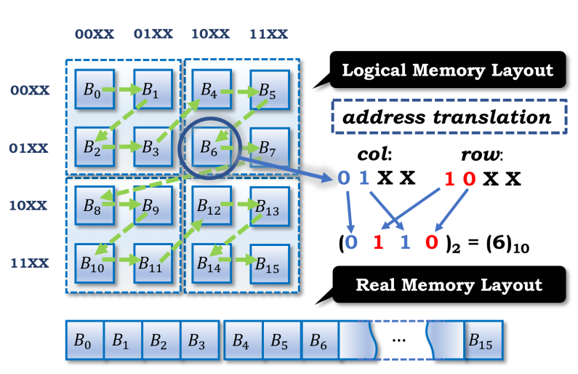
Accelerator based on Winograd convolution Sparse Winograd Convolutional neural networks on small-scale systolic arrays
Memory access patterns
Use Z-Morton memory layout to increases both spatial and temporal locality

Slide 13
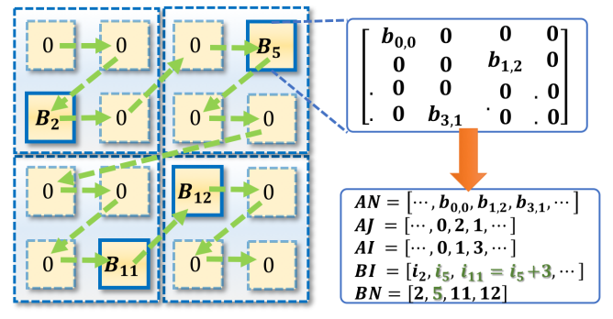
Accelerator based on Winograd convolution Sparse Winograd Convolutional neural networks on small-scale systolic arrays
Block-based sparse matrix compression
Block-based sparse coordinates

Slide 14
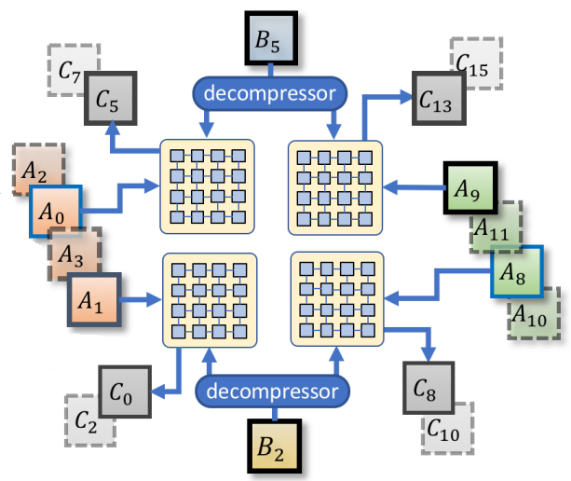
Accelerator based on Winograd convolution Sparse Winograd Convolutional neural networks on small-scale systolic arrays
Block-based sparse matrix compression
Modified systolic arrays for recursive sparse matrix multiplication

Slide 15
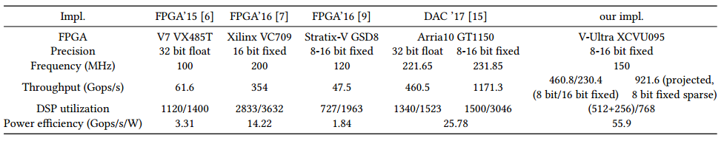
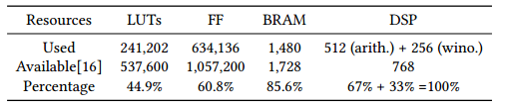
Accelerator based on Winograd convolution Sparse Winograd Convolutional neural networks on small-scale systolic arrays
Results
Scale: 8 clusters(four 4x4 systolic arrays as one cluster); 16 4x4 systolic arrays work on Winograd transform
Comparison
Resource usage

Slide 16
Accelerator based on Winograd convolution SpWA
Contributions
Propose a new dataflow by rearranging the data layout in sparse Winograd convolution
Propose an architecture based on SpWA dataflow with line buffer and sparse Winograd PE designs

Slide 17
Accelerator based on Winograd convolution SpWA
Contributions
Propose a new dataflow by rearranging the data layout in sparse Winograd convolution
Propose an architecture based on SpWA dataflow with line buffer and sparse Winograd PE designs

Slide 18
Accelerator based on Winograd convolution SpWA
Contributions
Propose a new dataflow by rearranging the data layout in sparse Winograd convolution
Propose an architecture based on SpWA dataflow with line buffer and sparse Winograd PE designs

Slide 19

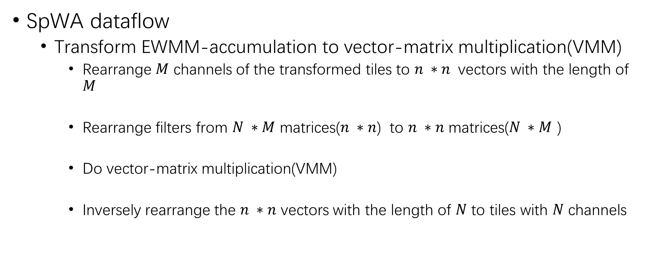



Accelerator based on Winograd convolution SpWA
SpWA dataflow
Transform EWMM-accumulation to vector-matrix multiplication(VMM)
Rearrange $M$ channels of the transformed tiles to $n ∗n$ vectors with the length of $M$
Rearrange filters from $N ∗M$ matrices($n ∗n$) to $n ∗n$ matrices($N ∗M$ )
Do vector-matrix multiplication(VMM)
Inversely rearrange the $n ∗n$ vectors with the length of $N$ to tiles with $N$ channels
$$V_{w}^{′}\left(i∗n+j,t\right)=V_{w}\left(t,i,j\right)$$
$$U_{w}^{′}\left(i∗n+j,k,t\right)=U_{w}\left(k,t,i,j\right)$$
$$Q_{w}^{′}\left(p\right)=U_{w}^{′}\left(p\right)V_{w}^{′}\left(p\right)$$
$$Q_{w}^{′}\left(i∗n+j,k\right)=Q_{w}^{}\left(k,i,j\right)$$

Slide 20
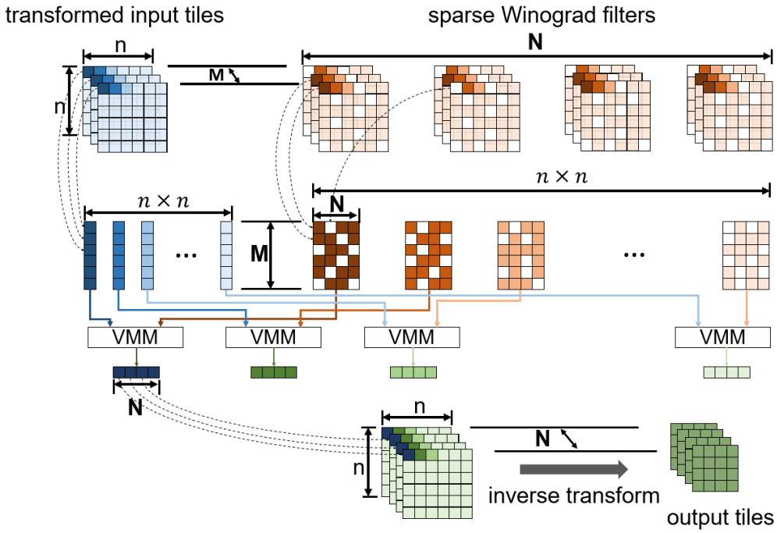
Accelerator based on Winograd convolution SpWA
SpWA dataflow

Slide 21
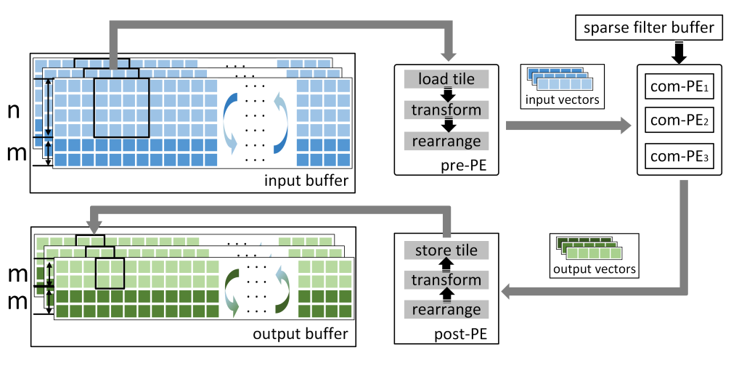
Accelerator based on Winograd convolution SpWA
SpWA architecture
Using Line Buffer to increase data reuse
Overview

Slide 22
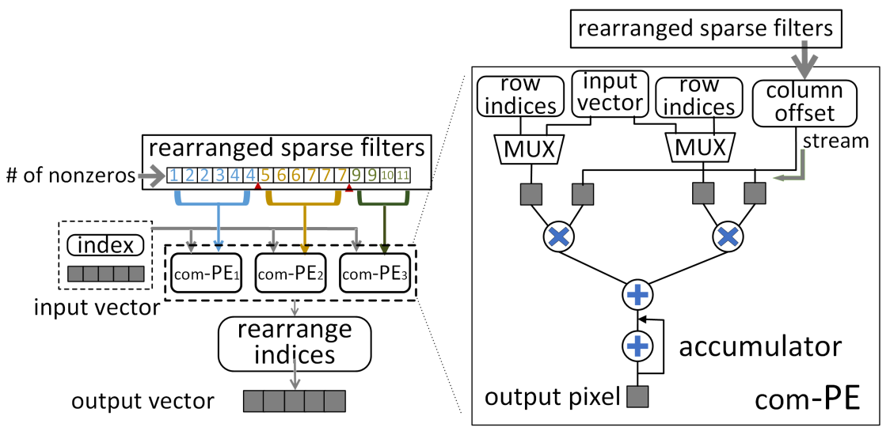
Accelerator based on Winograd convolution SpWA
SpWA architecture
PE architecture

Slide 23
Winograd-ReLU CNN
Motivaiton
The transformation of weights eliminating the gain from exploiting sparsity
Methods
Prune the weights after they are transformed
Move the ReLU operation to be after the Winograd transform

Slide 24
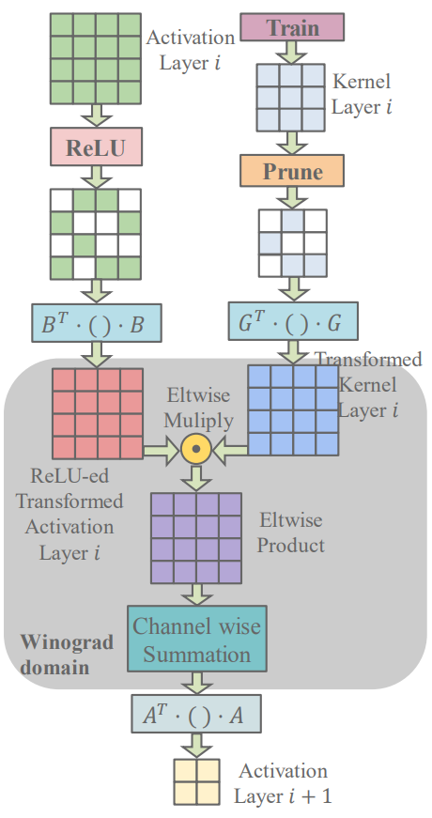
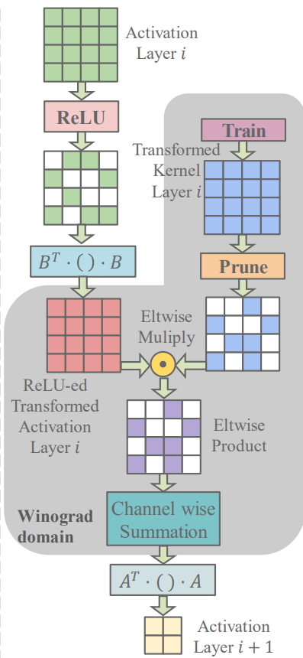
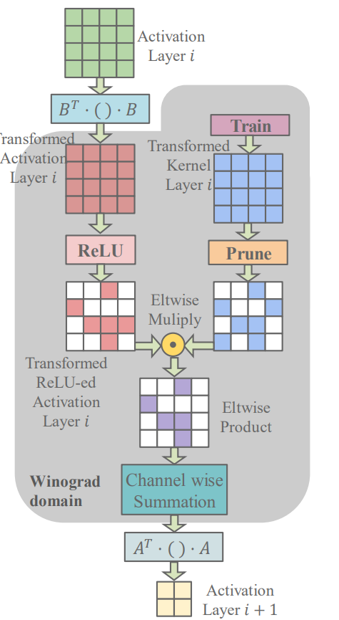
Winograd-ReLU CNN
Conventional Winograd Convolution
Pruning the transformed kernel
Moving ReLU after transformation

Slide 25
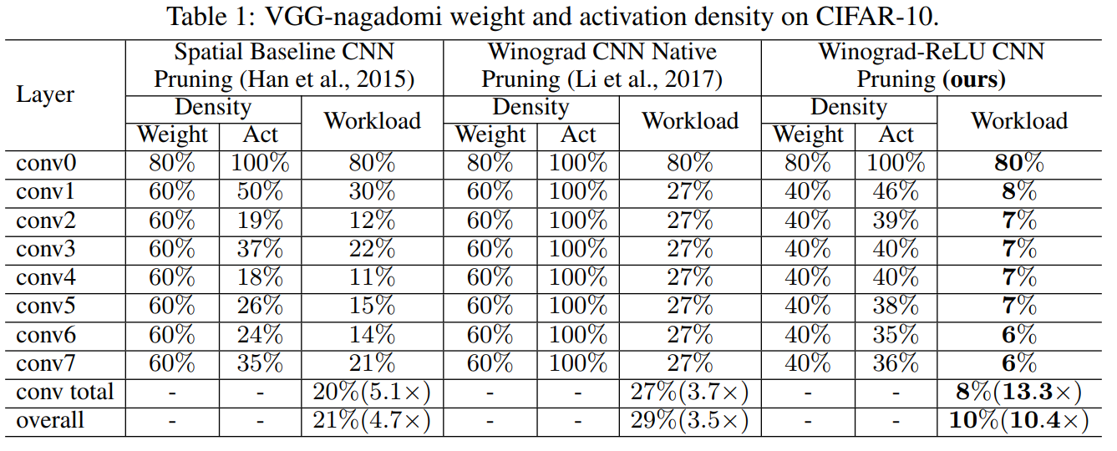
Winograd-ReLU CNN
Results

Slide 26
Thank you !

